Slide 1
Chapter 6: Classes of organic compounds
Alkanes, alkenes and alkynes

Slide 2
Bonding in carbon
The types of atoms present and the shape they are arranged in can determine the chemical interactions and reactions of an organic molecule.
In organic compounds, carbon atoms almost always form four bonds, as all four valence atoms are involved in bonding.
Single (C–C), double (C=C) and triple (CΞC) bonds form between carbon atoms, with excess valence atoms bonding with atoms such as hydrogen, oxygen and nitrogen.

Slide 3
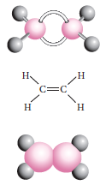
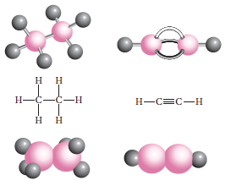
Bonding in carbon
Various models can be used to represent organic molecules including (top to bottom) ball and stick, structural and space filling models.

Slide 4
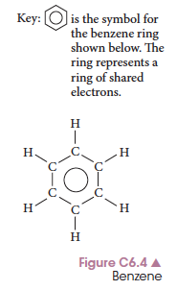
Hydrocarbons
Aromatic hydrocarbons contain one or more benzene rings.
Any other hydrocarbon is an aliphatic compound.
Any carbon with only single carbon–carbon bonds is a saturated hydrocarbon.
Unsaturated hydrocarbons contain carbon–carbon double and triple bonds

Slide 5
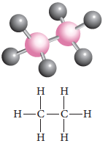
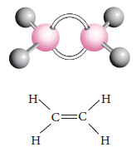
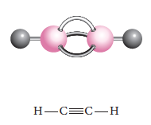
Hydrocarbons
Compounds with only carbon and hydrogen and:
All carbon–carbon single bonds are alkanes.
Carbon–carbon double bonds are alkenes
Carbon–carbon triple bonds are alkynes

Slide 6
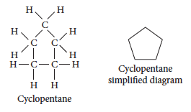
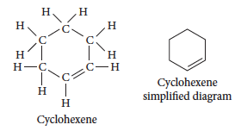
Hydrocarbons
In some hydrocarbons, the carbon atoms join to form a ring structure called an alicyclic or cyclic hydrocarbon.

Slide 7
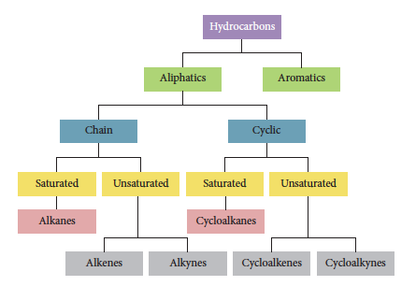
Hydrocarbons
A summary of the groups of hydrocarbons:

Slide 8
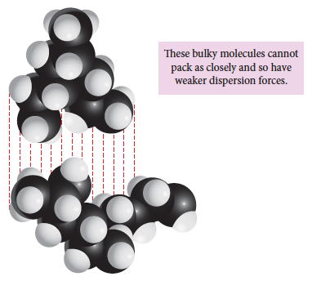
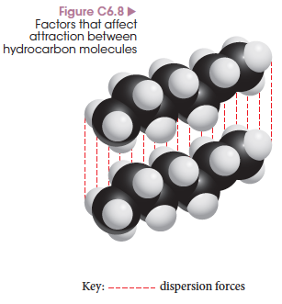
Structure and bonding
Hydrocarbons form dispersion forces between molecules, which are relatively weak, but increase with size of the molecule and proximity.

Slide 9
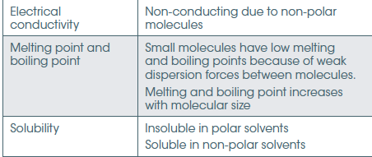
Alkane and alkene properties
Physical properties for alkanes, alkenes and alkynes are largely similar due to their similar structures and bonding between molecules.
Notes:
See Table C6.2 for the full table.

Slide 10
Structural isomers
Have the same molecular formula but a different structural formula.
The name of the molecule has be specific enough to allow each isomer to be identified.
Alkenes, cis and trans isomerism, geometric isomerism.

Slide 11

Chemical reactivity
All three types of hydrocarbons undergo combustion reactions.
Alkanes undergo substitution reactions where alkenes/alkynes usually do not. UV light causes substitution of halogen atoms for hydrogen atoms in the molecule.

Slide 12


Chemical reactivity
Alkenes and alkynes undergo addition reactions that alkanes do not.
Addition reactions break carbon–carbon double bonds and add small molecules like hydrogen or halogens to the larger hydrocarbon molecule.
Notes:
Experiment 6.1 – Comparing reactivities of alkanes and alkenes (teacher demo)

Slide 13
Chemical reactivity
Whilst Alkenes undergo addition reactions, benzene does not. This is because of the delocalized electrons making the ring stable forming a resonance structure.
Markovnikovs Rule.
When undergoing addition using say HCl or HBr, the hydrogen adds to the carbon with the most hydrogens and the halogen adds to the carbon with the fewest hydrogens.
Carbon 2.5 and Hydrogen 2.1 electronegativity.
Notes:
Experiment 6.1 – Comparing reactivities of alkanes and alkenes (teacher demo)

Slide 14
Chapter 6: Classes of organic compounds
Alcohols

Slide 15

Alcohols functional group
Alcohols contain the –OH functional group. This is known as the alcohol or hydroxyl group.
The hydroxyl group is reactive and determines the chemical properties of the molecule.

Slide 16
Naming
1 Identify the longest carbon chain in the molecule containing the hydroxyl functional group.
2 Remove the ‘e’ on the end of the name, and add ‘ol’. So butane becomes butanol.
3 Number the carbon atoms in the longest chain so the hydroxyl group is given the smallest number.
4 Allocate a positional number to the hydroxyl group. For example: 2-butanol
5 Name any alkyl side chains indicating position with a number. For example: 3-methyl-2- butanol

Slide 17
Properties
The oxygen in the hydroxyl group is highly electronegative so creates a strong polar bond within the functional group.
The hydroxyl group can form hydrogen bonds with other polar groups, raising the melting and boiling points.
They can also form hydrogen bonds to water, increasing solubility in water. Solubility decreases as chain length increases.

Slide 18
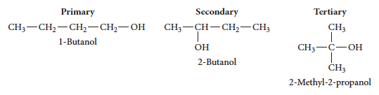
Primary, secondary and tertiary alcohols
A primary alcohol has one carbon atom bonded to the carbon atom of the hydroxyl group.
A secondary alcohol has two carbons bonded to the functional group carbon, while a tertiary alcohol has three carbons bonded. Written 1º, 2º, 3º

Slide 19

Preparation of alcohols
Ethanol (primary alcohol) is commonly prepared through fermentation of simple sugars in the presence of yeast.
Hydration (addition of water) of an alkene will also produce an alcohol, under acidic conditions. The final molecule chain length depends upon the reactant alkene.

Slide 20

Reactions of alcohols
Alcohols, like all hydrocarbons, will undergo combustion in air to form carbon dioxide, water and energy.
An alcohol can have water removed chemically (dehydration) by heating in the presence of a concentrated acid.

Slide 21

Reactions of alcohols
When alcohols react with sodium they form an ion called an alkoxide where the hydrogen ion is removed from the hydroxyl group leaving the hydrocarbon with an O– ion. Hydrogen gas also forms.
In this reaction, the ethanol acts like an acid, donating its hydrogen ion.

Slide 22

Oxidation of alcohols
Primary alcohols will oxidise when in the presence of a strong oxidising agent such as acidified permanganate ions (MnO₄–) or acidified dichromate ions (Cr₂O₇^{2–}).
They oxidise to form an aldehyde, which is then further oxidised to a carboxylic acid. [O] = oxidation has occurred.

Slide 23
Oxidation of alcohols
If the oxidising agent is added to an alcohol, the final product will only contain a carboxylic acid and no aldehyde because the aldehyde is very easily oxidised as an excess of oxidising agent is present.
To collect the aldehyde, it needs to be distilled as it forms, before it has a chance to oxidise further. The dichromate under mild conditions produces the aldehyde whereas the permanganate under acidic conditions will oxidise the alcohol straight to carboxylic acid.

Slide 24

Oxidation of alcohols
Secondary alcohols oxidise to form ketones. There is no further oxidation of a ketone.
Tertiary alcohols do not oxidise.
This reaction can be used to distinguish a tertiary alcohol from a primary/secondary alcohol as the oxidising agents show a distinct colour change when a reaction occurs. For example, dichromate ions (orange) form chromium ions (green).
Notes:
Experiment 6.2 – Distinguishing between primary, secondary and tertiary alcohols

Slide 25
Chapter 6: Class of organic compounds
Aldehydes, ketones and carboxylic acids

Slide 26
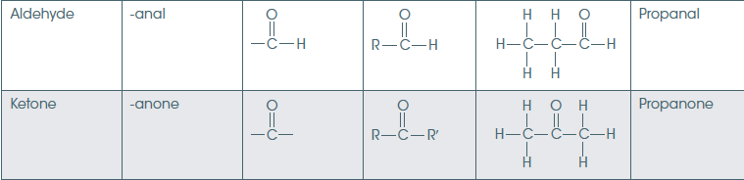
Aldehyde/ketone group
A carbon with a double bond to an oxygen atom is a carbonyl group. In the aldehyde the carbonyl is terminal (at the end of the chain). In the ketone the carbonyl is on a carbon in the middle of the chain.

Slide 27
Naming aldehydes and ketones
1 Locate the longest carbon chain that contains the carbonyl group.
2 Delete the ‘e’ from the alkane and add ‘al’ for an aldehyde and ‘one’ for a ketone.
3 Number the carbons in the chain so the carbonyl group has the smallest number, the aldehyde will always be a 1 so does not need to be allocated a number. Number the ketone according to position: 2-butanone
4 Name any alkyl side chains according to position and length: 3-methyl-2-butanone

Slide 28
Properties of aldehydes and ketones
The carbonyl group is highly polar because of the electronegativity difference between the carbon and oxygen atoms.
Dipole-dipole bonds form between molecules with carbonyl groups giving higher melting and boiling points than simple hydrocarbon molecules with dispersion forces.
As the carbonyl group can also form bonds with water, smaller aldehydes and ketones are water soluble.

Slide 29
Reactions of aldehydes and ketones
When a primary alcohol is oxidized, it forms an aldehyde then a carboxylic acid. If the aldehyde is distilled as it forms then it can be collected before it oxidises further.
Ketones are prepared by the oxidation of a secondary alcohol.
Aldehydes can be oxidised to form carboxylic acids, while ketones do not oxidise further.

Slide 30


Carboxylic acids
Carboxylic acids contain the carboxyl functional group – COOH.
The functional group is always on the end of the carbon chain.

Slide 31
Naming carboxylic acids
1 Identify the longest carbon chain that contains the carboxyl group.
2 Remove the ‘e’ of the alkane and add ‘oic acid’. For example propane becomes propanoic acid.
3 Number the carbons with the carboxyl group allocated the 1 carbon.
4 Name and number any alkyl side chains.

Slide 32
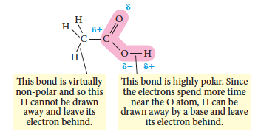
Properties of carboxylic acids
The carboxyl group can donate a hydrogen ion so acts as an acid. It undergoes normal acid-base reactions.
The carboxyl group contains a highly polar –OH bond which allows this to happen.

Slide 33
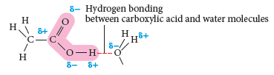
Properties of of carboxylic acids
The polar carboxyl group can form hydrogen bonds with other carboxyl groups so these molecules have relatively high melting and boiling points.
The carboxyl group can also form hydrogen bonds with water, so when the carbon chain is small carboxylic acids are soluble. As the carbon chain gets longer, the acids become less soluble and insoluble.

Slide 34
Intermolecular forces affect on mpt/bpt
Explain what forces are present in the following molecules:
Ethane bpt -89ºC
Ethanal bpt 20ºC
Ethanol bpt 78ºC
Ethanoic acid bpt 118ºC

Slide 35
Intermolecular forces affect on mpt/bpt
Explain what forces are present in the following molecules:
Ethane bpt -89ºC Dispersion only
Ethanal bpt 20ºC Dipole/Dipole
Ethanol bpt 78ºC H-bonding
Ethanoic acid bpt 118ºC Dipole/Dipole and H-bonding

Slide 36
Reactions of carboxylic acids
React with active metals to produce a salt and hydrogen gas:
React with a base in a neutralisation reaction to form a salt and water:

Slide 37
Reactions of carboxylic acids
If a metal carbonate is added then a salt and water and carbon dioxide are produced:
Addition of an alcohol with specific conditions produces an ester, another organic compound.

Slide 38
Chapter 6: Classes of organic compounds
Esters

Slide 39

What is an ester?
The ester functional group contains a carbon with a double bond to an oxygen and a separate single bond to another oxygen.
The group is in the middle of a carbon chain.

Slide 40
Synthesising esters
An alcohol and a carboxylic acid can be used to synthesise an ester.
Natural esters form very slowly. To speed up the reaction, the reaction is heated and a catalyst is used. Concentrated sulfuric acid is commonly used as the catalyst for this reaction.
This process is called esterification. A general equation for this process is:

Slide 41
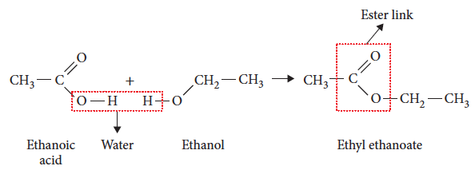
Synthesising esters
This reaction is an example of a condensation reaction. A molecule of water is formed as well as the ester.

Slide 42
Naming esters
Naming esters involves looking at the alcohol and carboxylic acid from which it was formed.
The first part of the name describes the alkyl group and comes from the alcohol it is formed from. This is the carbon chain attached to the oxygen within the chain. Example: ethyl, propyl
The second part is from the carboxylic acid. The end of the acid name is changed from ‘oic acid’ to ‘oate’. Example: butanoate, heptanoate
Notes:
Examples of names are in Table C6.7

Slide 43
Properties
The polar C=O and C-O bonds make the ester group polar. They only form dipole–dipole bonds between molecules.
Their melting and boiling points are higher than hydrocarbons, but lower than alcohols or carboxylic acids of similar size.
They do not form hydrogen bonds with water so are not soluble in water. Many esters are soluble in organic solvents.

Slide 44
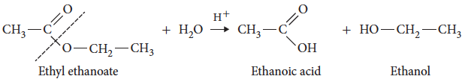
Reactions – acid hydrolysis
Acid hydrolysis of an ester involves reversing the formation reaction.
An acid is added, the mixture is heated and the ester splits to form an alcohol and carboxylic acid.

Slide 45
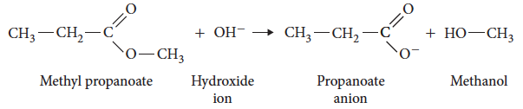
Reactions – alkaline hydrolysis
The splitting or hydrolysis of an ester can also be performed by adding a base and heating the mixture.

Slide 46

Fats and oils
Fats and oils are esters called triglycerides.
A triglyceride that is solid at room temperature is a fat, while one that is a liquid at room temperature is an oil.
A triglyceride has three ester groups in the molecule and is formed from the alcohol 1,2,3-propantriol (commonly called glycerol) and three, long chain fatty acids.

Slide 47
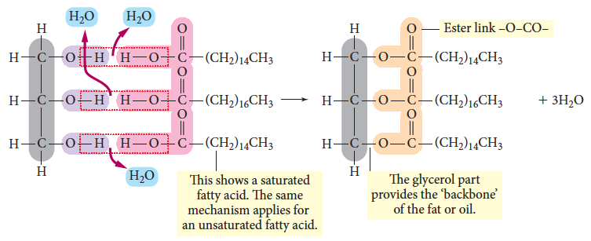
Production of a fat/oil
A fatty acid undergoes an esterification with one of the alcohol groups in glycerol.

Slide 48

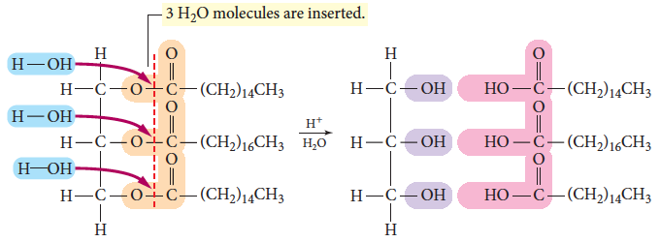
Hydrolysis of a fat/oil
Reversal of the formation reaction occurs when water is added to the fat/oil.
Notes:
Experiment 6.3 – Preparation of some esters.

Slide 49
Chapter 6: Classes of organic compounds
Amines and amides

Slide 50

What is an amine?
Amines are based on the ammonia molecule and contain the functional group –NH₂.
The hydrogen atoms on an ammonia molecule are replaced by alkyl groups to create amine molecules.

Slide 51

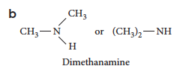
Primary, secondary and tertiary amines
Amines are classified as primary, secondary or tertiary based on the number of alkyl groups attached to the nitrogen atom.
A primary amine (a) has one alkyl group, while a secondary amine (b) has two alkyl groups.

Slide 52
Naming amines
1 Put the alkyl groups attached to the N atom into alphabetical order. Use the alkyl name for all except the final group.
2 Remove the ‘e’ from the last alkane name and add ‘amine’. Example: ethylmethanamine
3 Use di- and tri- if there are multiple identical alkyl groups.
4 Number the carbons, allocating the amine the lowest possible number.
5 Name any other side chains as for naming alkanes.

Slide 53
Properties of amines
The –NH₂ amine group is highly polar because of the large electronegativity difference between nitrogen and hydrogen.
This gives amines relatively high melting and boiling points as it can form hydrogen bonds between molecules.
Small primary and secondary amines are also soluble in water due to formation of hydrogen bonds.

Slide 54

Reactions of amines
As amines are weak bases, they will participate in neutralisation reactions with acids.
Reaction with an carboxylic acid forms an amide in a condensation reaction (to be examined later).

Slide 55

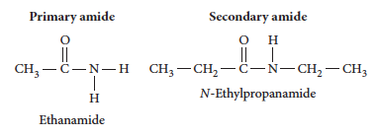
Amides
An amide contains a functional group that is part carboxylic acid C=O and part amine –NH.

Slide 56
Naming amides
1 Change the ending of the carboxylic acid name from ‘oic acid’ to ‘amide’. Example: propanoic acid becomes propanamide
2 Alkyl groups bonded to the nitrogen atom become N-alkyl. Example: N- ethylpropanamide

Slide 57
Preparation of an amide
Reaction of a carboxylic acid with an ammonium salt producing a salt, water and carbon dioxide.
The products are heated to dehydrate the salt, producing a primary amide.

Slide 58
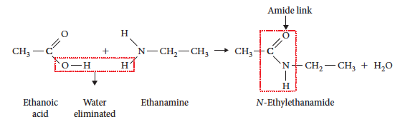
Preparation of an amide
Secondary amides are made when carboxylic acids and amines react together, a water molecule is eliminated. This is a condensation reaction.

Slide 59
Amide reactions
Hydrolysis of amides will result in formation of a carboxylic acid and amine.
This will occur under both acid and base conditions:

